Slide 1

PLANTATION ACRES HOMEOWNERS ASSOCIATION
BUSINESS SPOTLIGHT

Slide 2
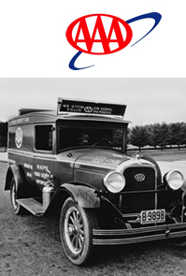
Origins of AAA
Motorists in the early 1900s faced a variety of obstacles. Rain often made the dirt roadways impassable, and dust from dry weather hampered drivers’ vision. Because stop signs and traffic signals were non-existent, there was danger at every intersection.
It was for these reasons that nine motor clubs around the country banded together in 1902 to form the American Automobile Association (AAA). The goal of this fledgling organization was to protect the rights and interests of its members and other automobile users and promote better highway and traffic safety.
Today, AAA has grown into more than 60 million members in the United States and Canada. Expanded services to include Travel, Home, Auto and Life Insurance, Annuities, Banking and Credit Cards.

Slide 3
Phillip Kittell - Homeowners and Auto Insurance Specialist.
With over twenty-five years’ experience in the insurance and financial industry. My primary concern is listening to and understanding my client’s goals and objectives to meet their individual and family insurance needs.
Protecting your home is a top priority
Your home is one of your most valuable investments and may even be part of your retirement planning. So, it’s essential to insure through a company that you can trust will be there when you need it.
With home insurance through AAA, I can help you obtain the coverage you need and the service you deserve.

Slide 4
June 23, 2022—With its overabundance of unneeded new roofs on homes, and flashy lawyer billboards at every turn claiming massive settlements on claims, Florida’s insurance market is on the verge of failure. Even more, this man-made catastrophe is causing financial strain on resident consumers, as the annual cost of an average Florida homeowners insurance policy will skyrocket to $4,231 in 2022, nearly three times more than the U.S. annual average of $1,544, according to an Insurance Information Institute (Triple-I) analysis.
“Floridians pay the highest homeowners insurance premiums in the nation for reasons having little to do with their exposure to hurricanes,” said Sean Kevelighan, CEO, Triple-I. “Floridians are seeing homeowners insurance become costlier and scarcer because for years the state has been the home of too much litigation and too many fraudulent roof replacement schemes. These two factors contributed enormously to the net underwriting losses Florida’s homeowners insurers cumulatively incurred between 2016 and 2021.”
Two major hurricanes made landfall in the state since 2016: 2017’s Irma and 2018’s Michael. No direct hits occurred in Florida over the past three hurricane seasons (2019-2021). Florida, however, is the site of 79 percent of all homeowners insurance lawsuits over claims filed nationwide while Florida’s insurers receive only 9 percent of all U.S. homeowners insurance claims. The Florida Office of Insurance Regulation (OIR), reported $51 billion was paid out by Florida insurers over a 10-year period and 71 percent of the $51 billion went to attorneys’ fees and public adjusters. The 2020 and 2021 cumulative net underwriting losses for Florida’s homeowners insurers totaled more than $1 billion each year.
“The state’s homeowners insurers have been forced to respond to these unfortunate market trends this year by restricting new business, non-renewing existing policies and even canceling policies mid-term. What’s more, four homeowners insurance companies have been declared insolvent since February — all while more Americans are moving to Florida than any other state” Kevelighan stated.
FLORIDA HOMEOWNER INSURANCE MARKET CONDITIONS

Slide 5
Companies in Rehabilitation & in Liquidation
AMERICAN CAPITAL ASSURANCE CORPORATION
AVATAR PROPERTY AND CASUALTY INSURANCE COMPANY
FEDNAT INSURANCE COMPANY
FLORIDA SPECIALTY INSURANCE COMPANY
GUARANTEE INSURANCE COMPANY
GULFSTREAM PROPERTY AND CASUALTY INSURANCE COMPANY
PHYSICIANS UNITED PLAN, INC.
QUALITY HEALTH PLANS, INC
SAWGRASS MUTUAL INSURANCE COMPANY
SOUTHERN FIDELITY INSURANCE COMPANY
ST. JOHNS INSURANCE COMPANY, INC.
SUNSHINE STATE INSURANCE COMPANY
UNIVERSAL HEALTH CARE INSURANCE COMPANY, INC.
UNIVERSAL HEALTH CARE, INC.
WESTON PROPERTY & CASUALTY INSURANCE COMPANY
WINDHAVEN INSURANCE COMPANY

Slide 6
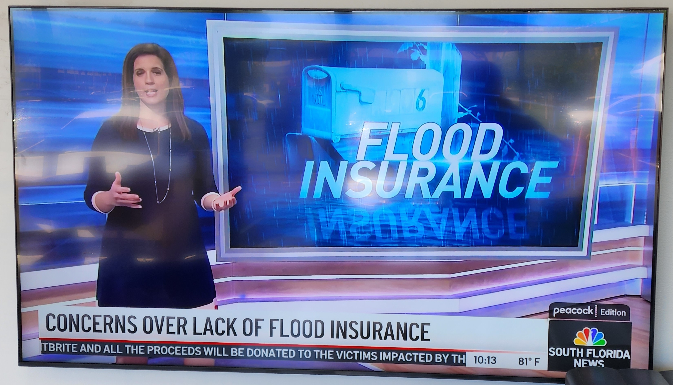

Slide 7
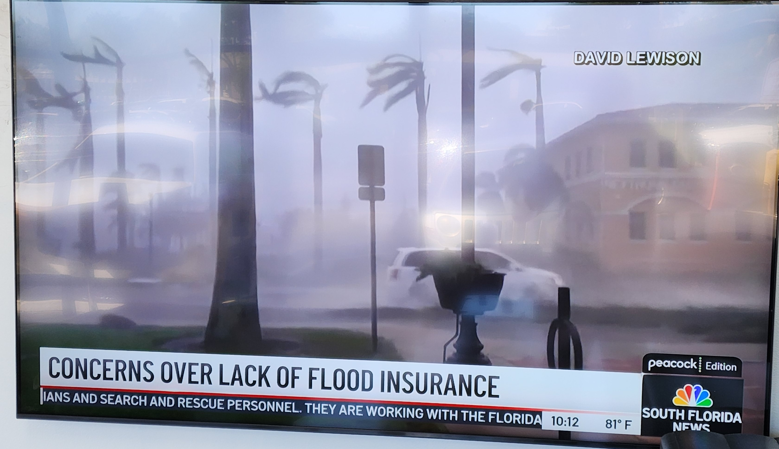

Slide 8
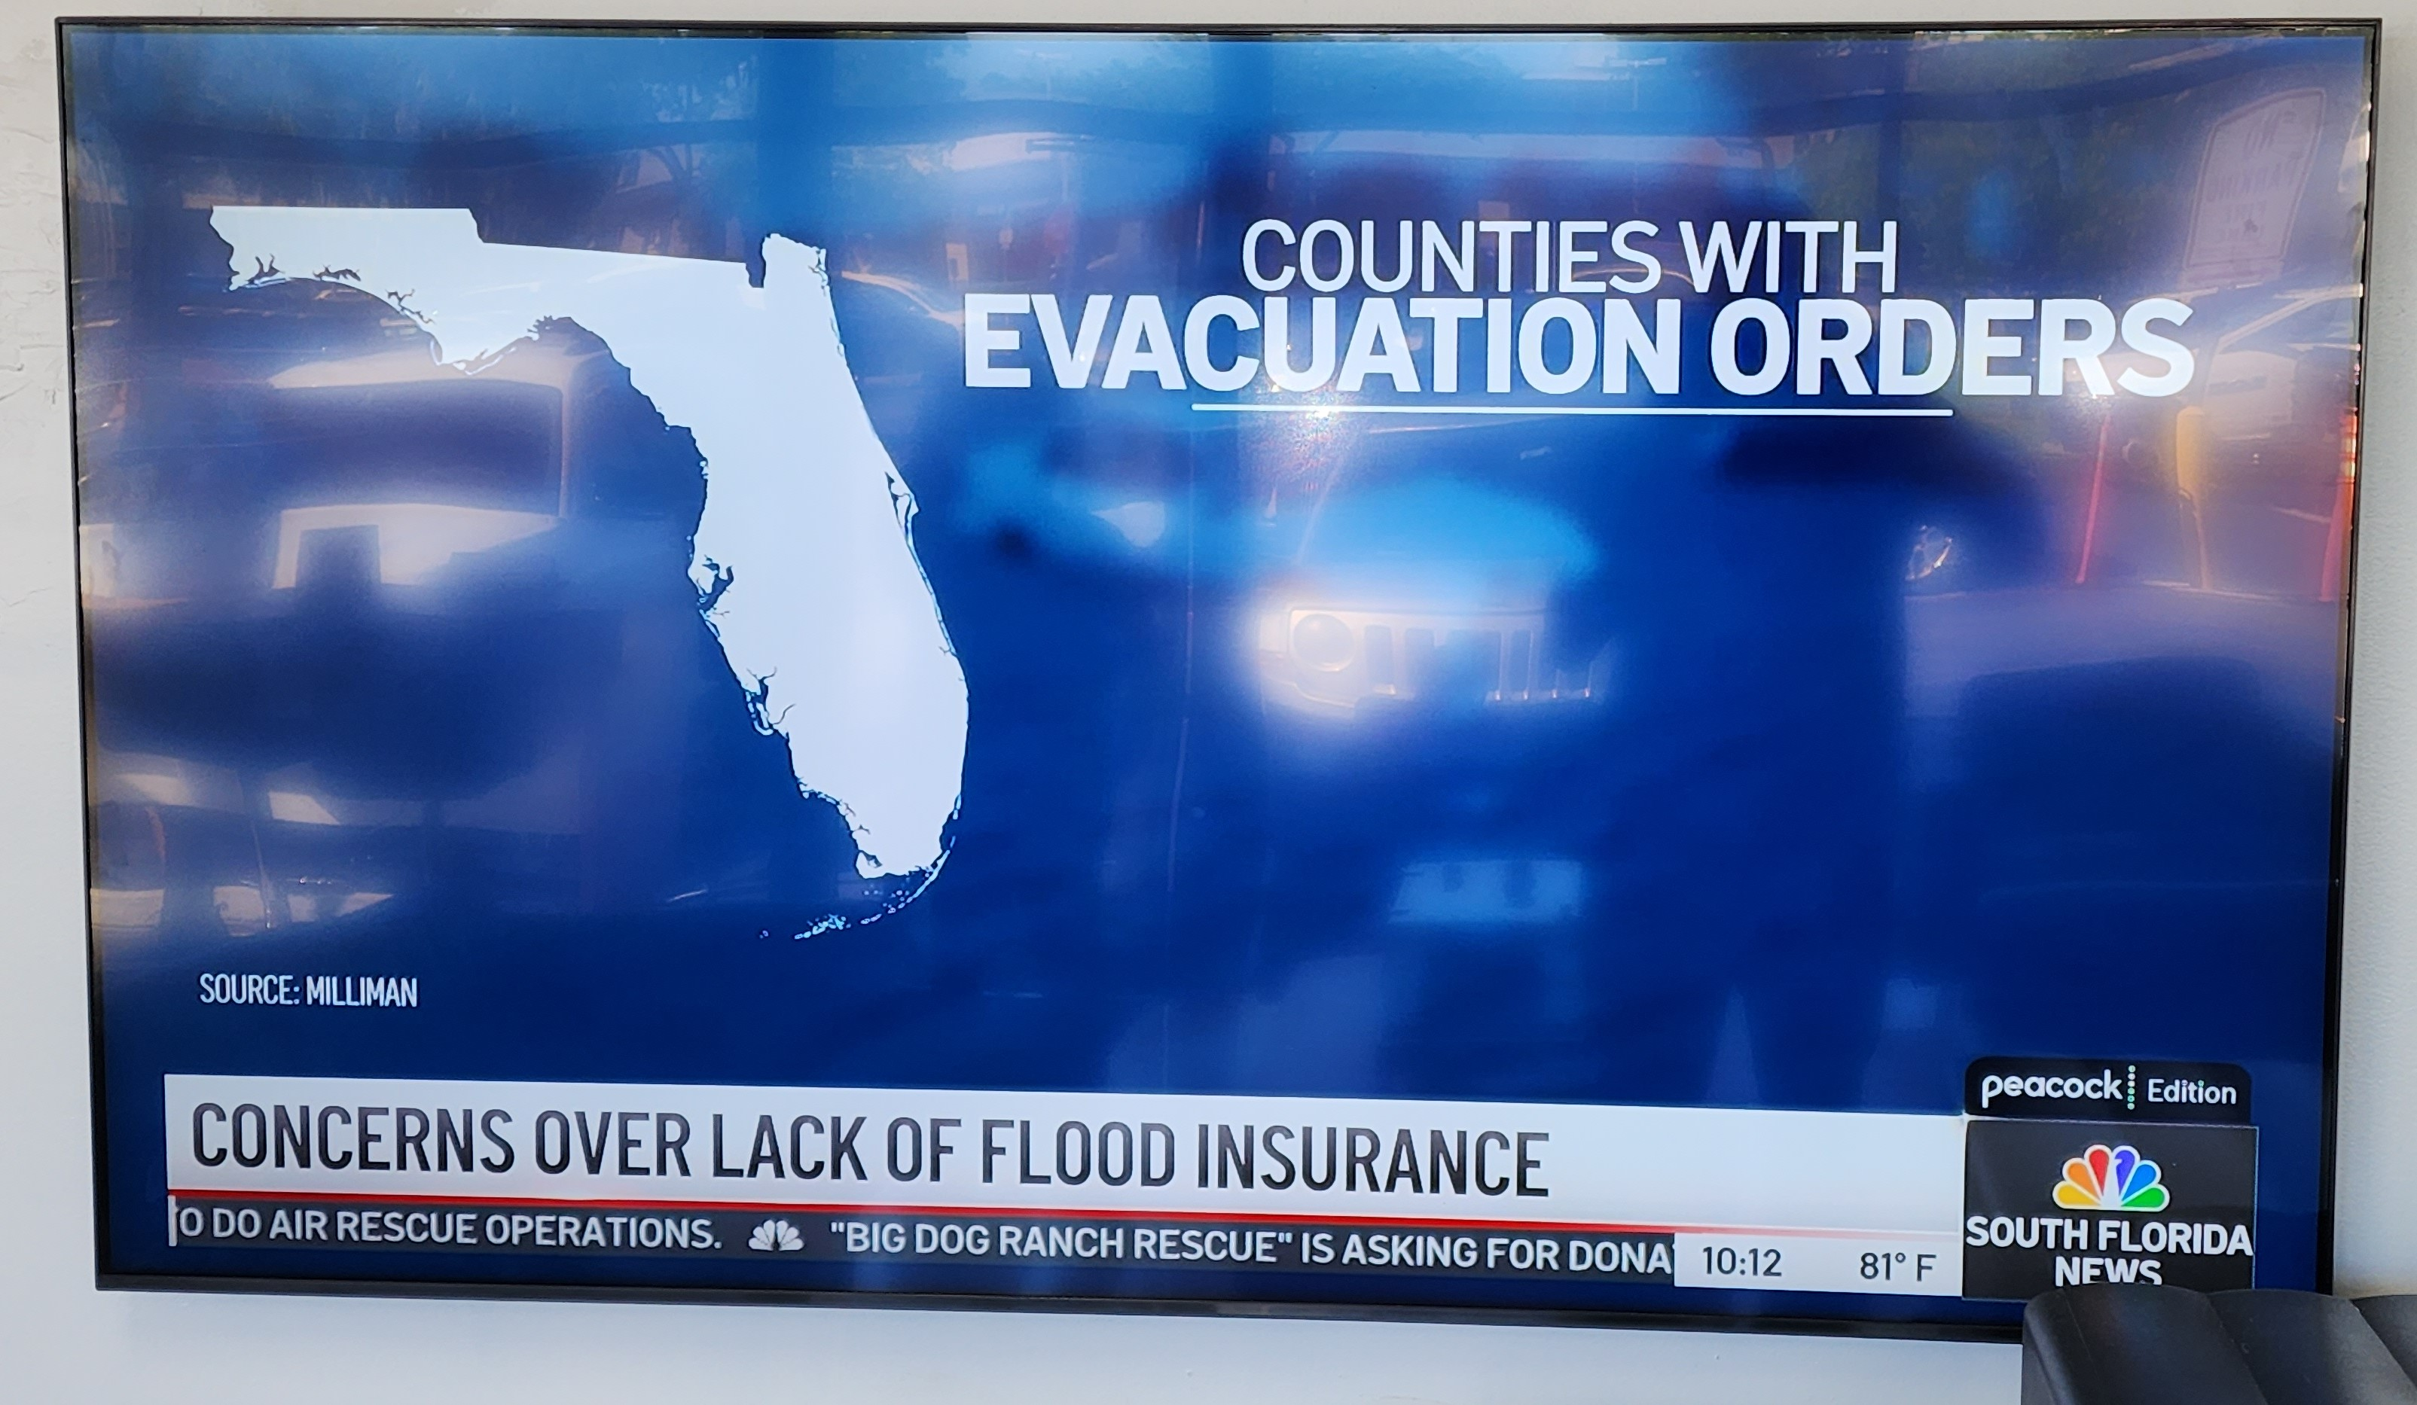

Slide 9
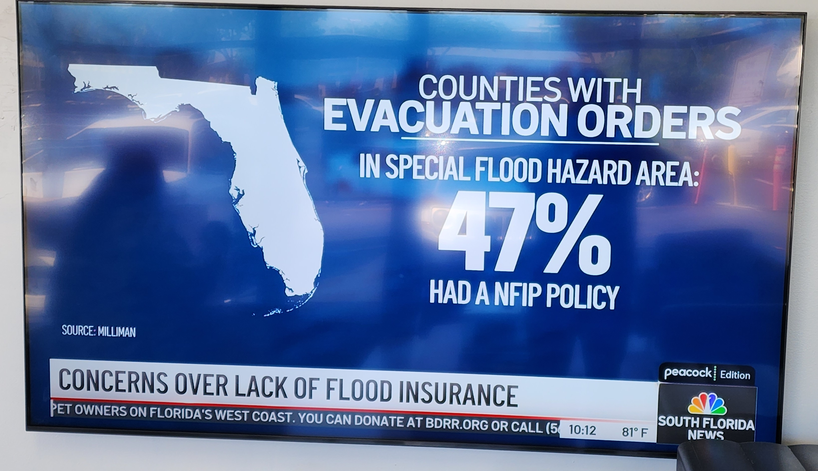

Slide 10
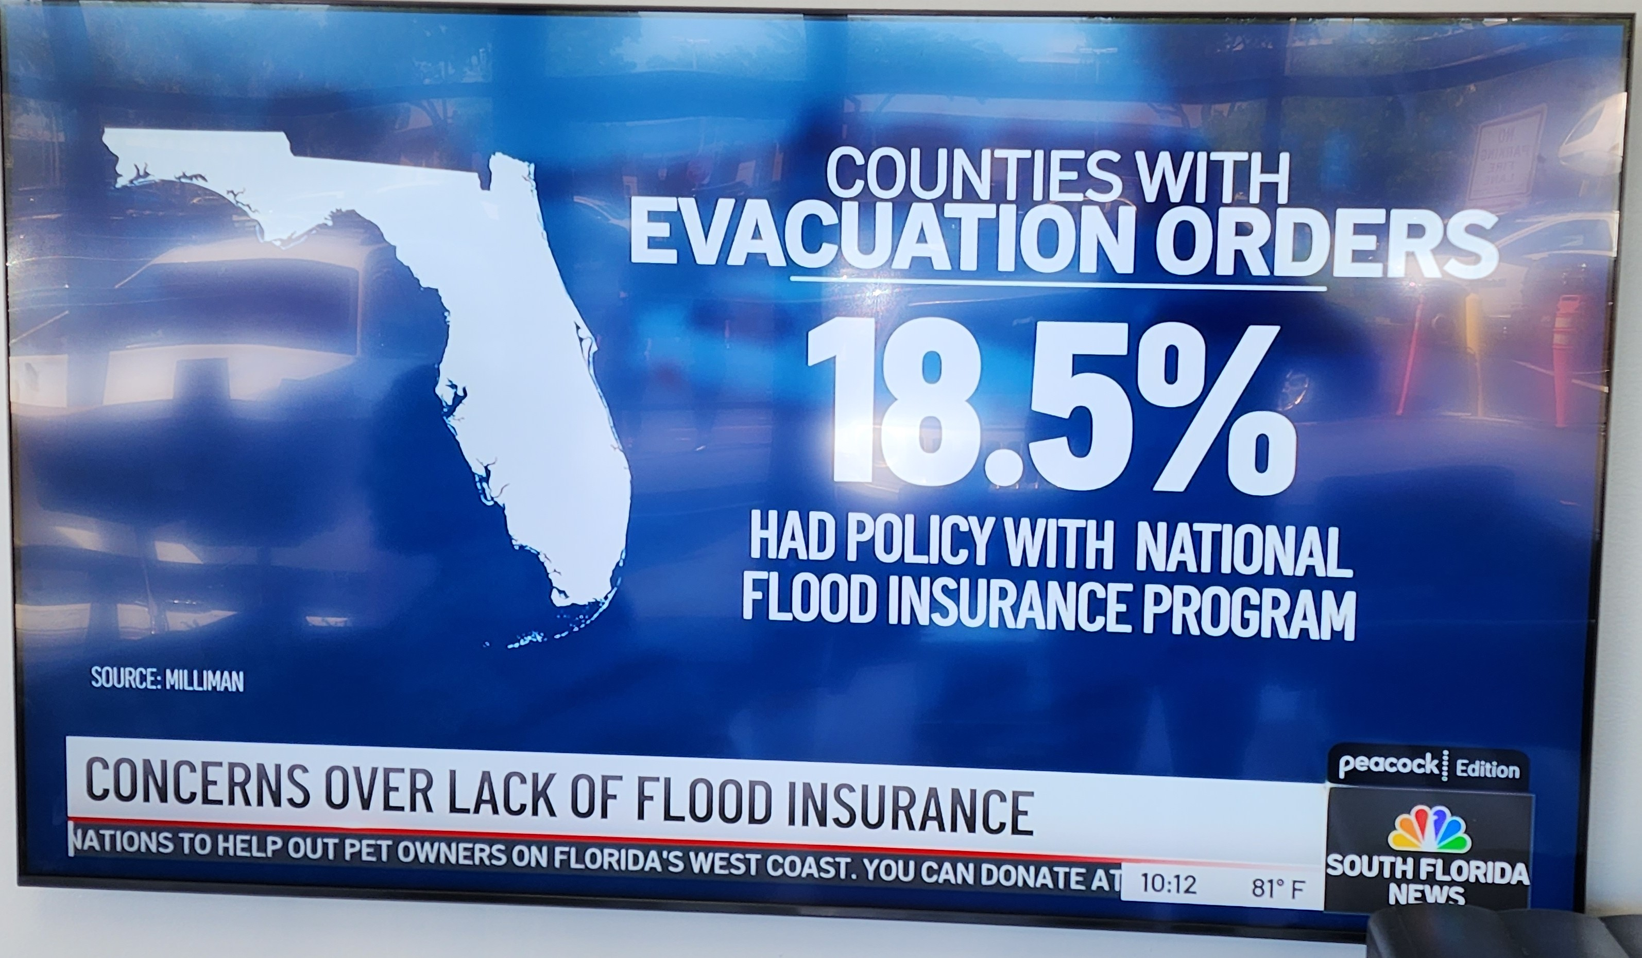

Slide 11
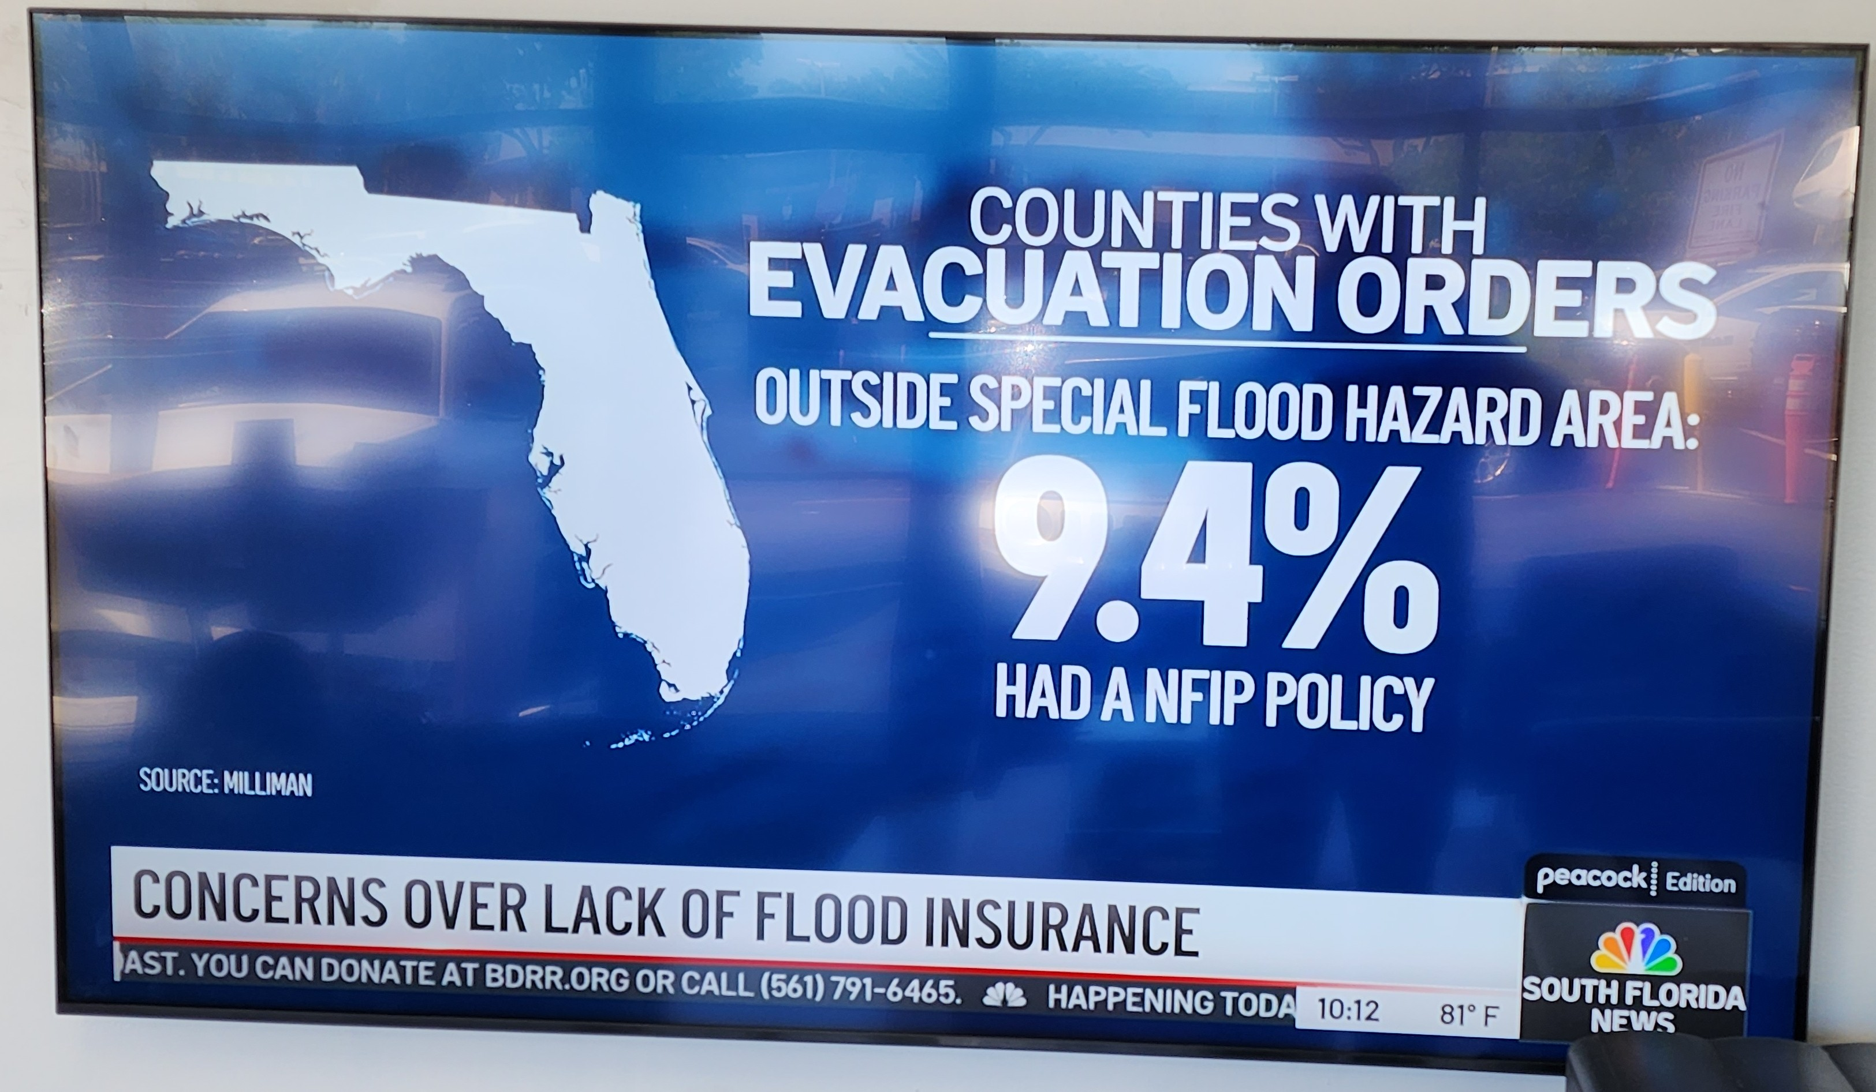

Slide 12
AAA HOMEOWNERS INSURANCE ADVANTAGES
AAA Owned & Operated
  Continuing the commitment to customers by offering the high standards of customer service and timelines that AAA has been providing for over 100 years.
Simplicity of One Policy
  The Package Policy is one convenient policy for both home and auto with one point-of –contact, one easy payment and one deductible if the home and auto are damaged by the same covered event.
COVERAGE FEATURES
  Homeowner Coverage
    Unlimited Water Coverage (only carrier in FL who offers it)
    Sinkhole coverage automatically included
    Coverages for Horse Communities (many carriers do not write)
    One deductible
    Flood Insurance
    Additional Liability Protection up to $2 million dollars
    Discounts Available
      Hurricane Rated Protection – Impact windows and doors, Shutters
      Central Alarms – Burglar and Fire Alarms directly to respective department
      Age of Roof
      AAA Credit Card
      Multi-Car Household

Slide 13
AAA HOMEOWNERS NSURANCE ADVANTAGES
COVERAGE FEATURES
  Auto Coverage
    Accident Forgiveness
      No premium surcharge for the first at-fault accident if you have had the Package Policy for two or more years without having any accidents in the last three years
    Collision Deductible Waiver
      Your collision deductible will be waived if you completely not at fault in an accident and the at-fault party can be identified by name.
    No Deductible on Window Glass
      AAA will waive the Other Than Collision Deductible for repair or replacement of any window glass.
    Original Equipment Manufacturer
      All structural replacement components used will be produced by the original equipment manufacturer
SAVINGS ADVANTAGE
  Discounts Available
    AAA Membership Discount
    Same Prior Auto and Home Carrier Discount
    Good Student Discount
    Driver Training Discount
    Mature Operator Motor Vehicle
    Accident Prevention Course Discounts
    Pay in Full Discount
    Vehicle Safety Feature Discounts

Slide 14
AAA HOMEOWNERS INSURANCE ADVANTAGES
    QUESTIONS
    &
    ANSWERS

Slide 15
AAA HOMEOWNERS INSURANCE ADVANTAGES
    PHIL KITTELL
    HOME AND AUTO INSURANCE SPECIALIST
    Direct: (954)-377-6656
    Pkittell@acg.aaa.com
    autoclubsouth.aaa.com/phillip.kittell

